Slide 1



Slide 2
About Demo China 2012
Conference format
  6-min presentation/demo + 9-min Q&A
Who demonstrates
  CEO
  Founder and other core members
Required material
  Application Form for 2012 Demo China
  Script and AV Demand
  6 pages PowerPoint for presentation
  Attendee Information
  3 minutes video about the product and team
  Optional material
  Product

Slide 3
How to prepare the PowerPoint
  6-min demonstration ：
  Part 1：Product demonstration (video and live product demonstration preferred)
  What do you do
  Who is your target customer
  What kind of specific problem do you solve
  Part 2： How do you solve this problem
  Your current performance
  Your products and services Vs your competitors?
  Your core competitive ability
  Part 3： Business Model and market prospect
  Part 4： Team Strengths
  Core team members and relevant experience

Slide 4
Tips for Presentation:
  Clarify your points or argument
  Keep your presentation to the basic information and comment that you want to put across. As a general rule, it is better to concentrate on a few points in detail than to try to cover everything with only a sentence or two per point.
  Make your visual aids distinctive…
  Avoid information overload and do not simply read out each slide as you give the presentation. The whole point of the visual aid is to illustrate your points, not completely duplicate them.
  Be aware of the judges
  Take time to find out a little about any potentially important industry figures who may be in the audience. If one of them asks a question, you might be able to recognize them and deliver some kind of tailored reply, directed at their firm or business practices.

Slide 5
Tips for Presentation:
  Get to know the venue
  On the day of the presentation, make sure you set up all necessary equipment in plenty of time. If you’ll be using microphones, a laptop, a slide projector or a big-screen TV make sure you test them before the audience arrives.
  Rehearse
  Practice your presentation in full at least ten times, ideally in front of an audience of trusted friends.
  Know your time
  Have a general idea of how long your speech should be so to not inconvenience the audience or delay the event.
  You are not an entertainer
  The best way to win an audience over is to deliver a good, memorable presentation on the subject matter. Occasional jokes or funny story can add a human touch to an otherwise boring subject. Avoid jokes about sex, age, race, social class or language barriers.

Slide 6

Entrance requirements
  No Specific Industry Requirements
  Annual revenue of no more than RMB 200 million
  The company is incorporated already and can provide product in demo version at least
  The company will have high growth and its own product and service has to be innovative.
  Screening criteria
  Do you have innovative product、technology or business model?
  Will your business expand widely or grow fast?
  Do you have a capable management team?
  Do you have a viable business plan?
  Entry Process
  Please login the Official Website of Demo China 2012：http://demochina.cyzone.cn/demochina2012/
  Click on the Home Page
  Fill in and submit the Application Form of Demo China 2012

Slide 7
Entry Process
  For each city, 20 startups will be selected by The Committee of Demo China to the regional contest
  Each selected company will be notified by The Committee of Demo China with the 6-min presentation guidelines
  The unselected companies can apply to be audience
  Demo Show （Top 20）
  6-min presentation/demo + 9-min Q&A with VC
  According to the score the score from judges，Top 5 will be selected to attend the Final in Hangzhou

Slide 8
Video Library of Demo
Aiax
http://bcove.me/z2f9ywpz
ApSynth
http://bcove.me/4nfg1al7
CVAV Systems
http://bcove.me/5z936fzu
Demo Spring 2012 Demonstrators
http://demo.com/ehome/DEMO/alumni/video-library

Slide 9




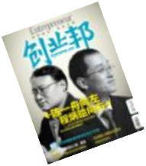
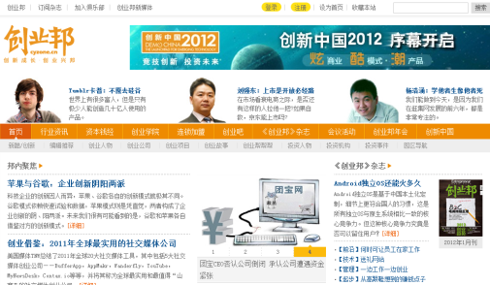





About Entrepreneur China
Founded in 2007, Entrepreneur China Magazine is a monthly commercial journal focusing on innovation, start-ups and their growth.We focus on the most innovative commercial leaders of new generation in China and build a platform to connect entrepreneurs with investors, hi-tech business parks, business schools andother advisory companies.
CYZONE.cn is the most influential domestic portal and interactive platform focusing on entrepreneurs and start-ups.
No. 1 entrepreneurial and investment portal with 1.2 million average daily PV and 150,000 registered users
Entrepreneur China has a series of influential event:
DEMO CHINA
Entrepreneur 100 + Entrepreneur China Annual Forum
China Angel Investors Forum
CEO Club
Entrepreneur China Angel funds is an institutional angel fund that invest in native Chinese firms who are in the phase from Seed stage to early stage, and have great potential to achieve huge growth. Besides pure financial investment, the fund also specializes in providing value-added services, to portfolio companies.

Slide 10

Contact us
Entrepreneur China Media
Room 908,Xueyuan International Building, No.1 Zhichun
Road Haidian District, Beijing, 100191, CHINA
Tel : (86)10-66422920/22
Fax: (86)10-66422926
Email: demochina@cyzone.cn
Http://demochina.cyzone.cn

